Slide 1
ETMCC v2.0
Ivan S Zapreev, Maneesh Khattri,
Joost-Pieter Katoen

Slide 2
Outline
Goals
Data structures and Algorithms
PRCTL
ETMCC v2.0 vs. v1.0
Extensions
Conclusions

Slide 3


Goals
Develop a unified tool for
PCTL, CSL, PRCTL and CSRL
Improve and extend ETMCC v1.0
  Use efficient data structures
  Use improved algorithms for CSL
    Steady state detection
    Faster BSCCs search
    etc. ;

Slide 4

Data structures and Algorithms
Data structures:
  Sparse Matrix special representation
  Matrix Vector multiplication
Algorithms:
  Direct search only for required BSCCs
  Collapse states
  Bisimulation minimization
  On the fly steady state detection

Slide 5
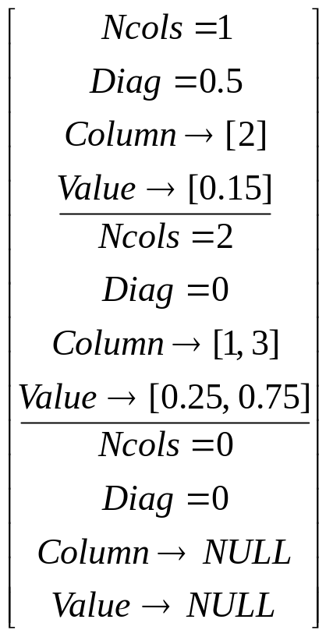
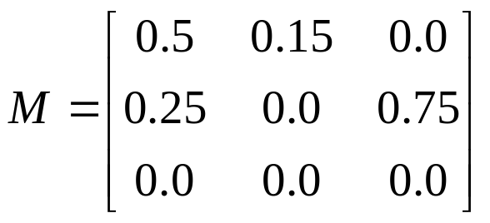
Data Structure
Make states absorbing
Compute Uniformized DTMC from CTMC

Slide 6
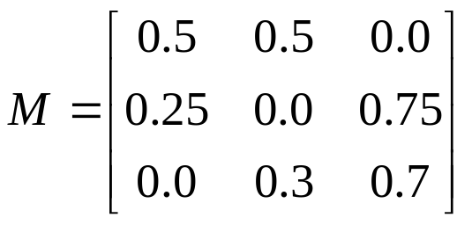
Fast M*v and v*M multiplication
Linear memory allocation,
Multiply only certain – valid elements,
Rely on the matrix row elements ordering,
Multiply v*M by row;
1 row
2 row
3 row
0.5
0.5
0.5
0
2
1
Col. id
0.25
0.75
0.3
0.5
0.25
0.75
Val.
0.3
0.7
0.7
Diag.
0.7
0.5
0.0
0.5
0.5
0.05
0.05
0.0
+
0.1
0.2
0.3
*
0.25
0.75
=
0.05
0.0
0.15
=
0.1
0.14
0.36
+
0.7
0.3
0.0
0.09
0.21

Slide 7
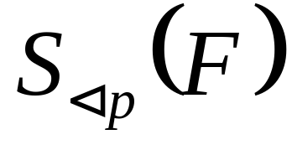

Searching for BSCCs,
Based on Tarjan’s algorithm for searching MSCCs:
  Search for BSCC, not MSCC
  Find BSCCs for Sat(F) states
  If => stop
The complexity remains O(N+M)
BSCC
A
B
E
BSCC
C
D

Slide 8


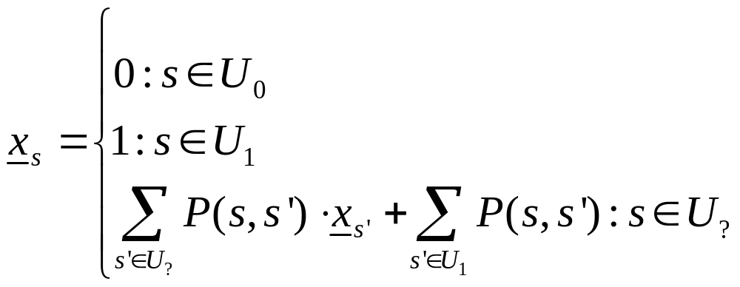
Unbounded until Pr(ΦU Ψ)
  Unbounded Until
  U₀= no path through Φ-states exists to a Ψ-state
  U₁= Prob. Measure to reach Ψ-state through Φ-states is 1
  Then Prob(s, Φ U Ψ) is:

Slide 9
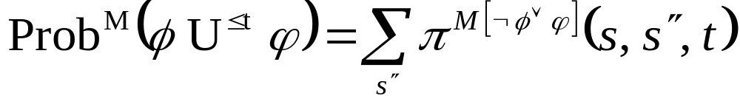
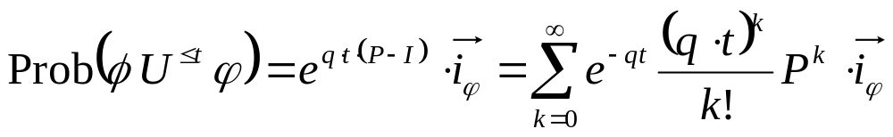
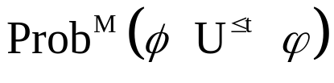
Bounded until (CSL)
Bounded Until can be computed as:
The solution:
Using uniformisation:
Interval Until: Modification of

Slide 10
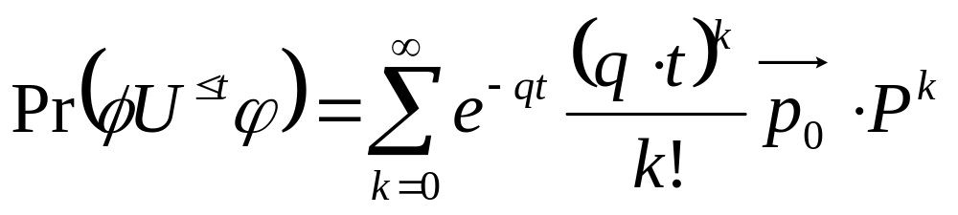
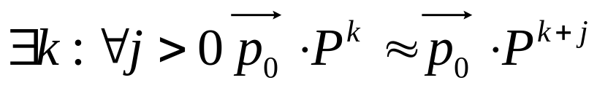
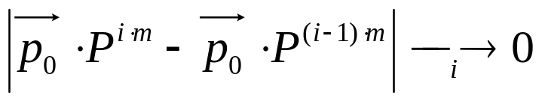
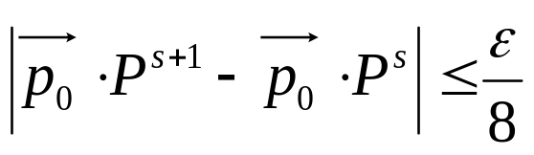
Steady state detection
Steady state
Detect steady state
  Check sequence convergence
  Check final convergence

Slide 11
Outline
Goals
Data structures and Algorithms
PRCTL
ETMCC v2.0 vs. v1.0
Extensions
Conclusions

Slide 12
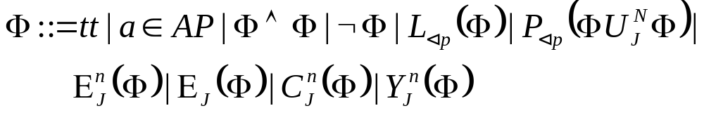






PRCTL logic
Syntax:
Semantics:
- Long-run probability meets probability bound
- Path-probability operator for until formula
- Expected reward rate up to n-th transition for phi-states meets reward bound
- Long-run expected reward rate for phi-states meets reward bound
- Instantaneous reward rate in phi-states meets the reward bound
- Expected accumulated reward until the n-th transition meets the reward bound

Slide 13
PRCTL model checking
All formulas have been implemented
Slight modifications: Until formula (Path Graph)
[Andova et al. 2003]
[ETMCC v2.0]
Rewards
states
Tuples (s,p)
Tuples (r,p)
Time n
…
…
Tuples (s,p)
Tuples (r,p)
Better access to the rate matrix

Slide 14
Outline
Goals
Data structures and Algorithms
PRCTL
ETMCC v2.0 vs. v1.0
Extensions
Conclusions

Slide 15

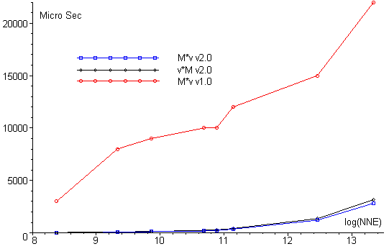
ETMCC v2.0 vs. v1.0
Matrix vector multiplication:

Slide 16

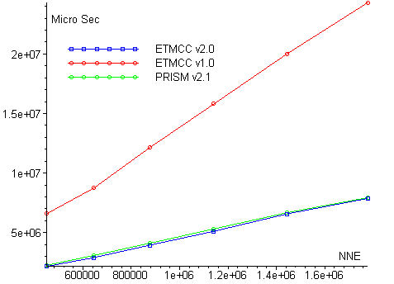
ETMCC v2.0 vs. v1.0
The Cluster Computing example
http://www.cs.bham.ac.uk/dxp/prism/cluster.html

Slide 17

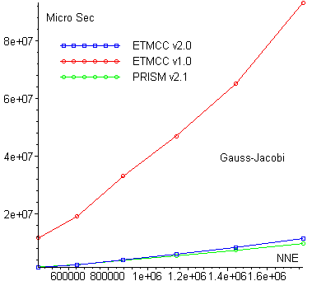
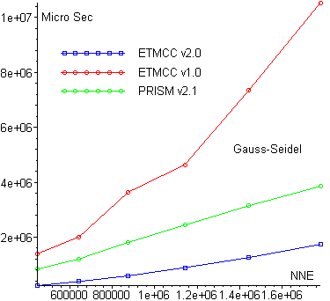
ETMCC v2.0 vs. v1.0
The Cluster Computing example

Slide 18
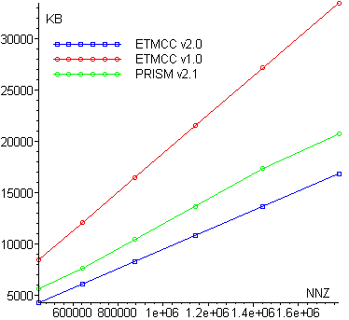
ETMCC v2.0 vs. v1.0
The Cluster Computing example, space usage

Slide 19
Outline
Goals
Data structures and Algorithms
PRCTL
ETMCC v2.0 vs. v1.0
Extensions
Conclusions

Slide 20
Re-sorting the matrix
Speed up matrix vector multiplication in iterative methods for steady state operator (BSCC) and making states absorbing.
1 row
2 row
3 row
4 row
M =
nnz
0.5
0.5
0.2
0.8
0.25
0.75
0.1
0.8
0.1
2 row
4 row
M =
0.2
0.8
0.1
0.8
0.1
1 row
3 row
Ms =
0.5
0.5
0.25
0.75

Slide 21
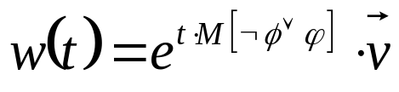

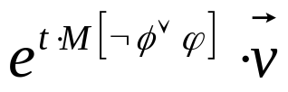
Krylov Subspaces
Solution of the linear differential equation
Typical approach – Uniformisation
  Makes elements positive
For Krylov-based algorithms work
better [R. Sidje].
  Compute at once
  Map w(t) onto a much smaller subspace

Slide 22
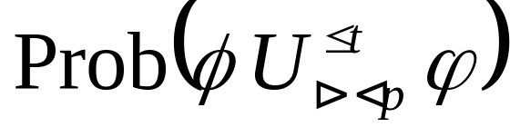

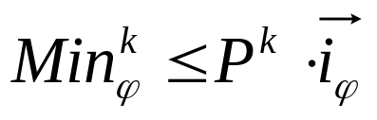
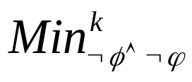
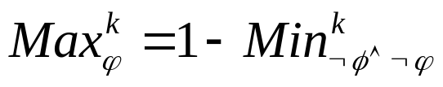
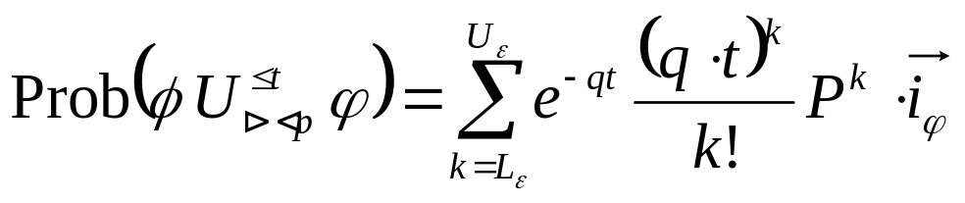
The estimate
Idea 1:
In DTMC consider only some paths to .
Get estimate.
Idea 2:
In DTMC compute ,
then .
Idea 3:
The estimates for CTMC are now obtained
with the formula:

Slide 23
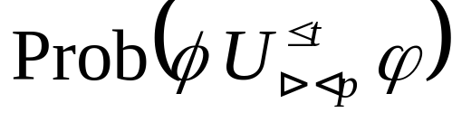
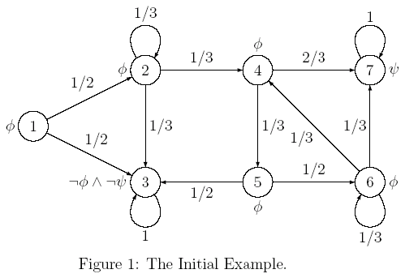
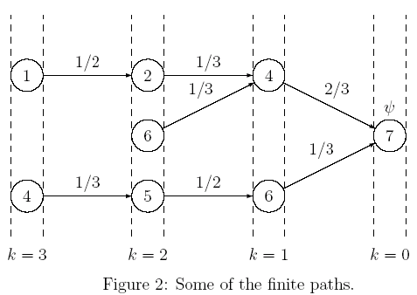





Example for the estimate

Slide 24

Conclusions
Support PCTL, CSL, PRCTL logics
The implementation is faster
Ongoing work:
  Incorporate CSRL logic
  Collapse states
  Involve bisimulation minimization
  Further v*M, M*v improvement

Slide 25
Any further wishes?
Link to BDD implementation?
Graphic User Interface?
etc.

